Slide 1
UNIT
DAY 4
01
EVERYTHING IS A NUMBER
GAMES OF LOGIC
AGENDA
REMINDERS
Put your phones into The Holding Cell
Put your computers away, you won’t be needing them until the end
Warm Up Question
Text as Numbers
Encoding/Decoding
Images as Numbers
Bitmap Exchange
Sound as Numbers
Compression

Slide 2

THE WARM UP QUESTION
01001000
what is it?

Slide 3
THE WARM UP ANSWER
01001000 = 72 in decimal
01001000 = 48 in hex
01001000 = H in ASCII
01001000 = one row of pixels ▫▪▫▫▪▫▫▫
01001000 = one sound sample, 72 out of 255

Slide 4
THE WARM UP ANSWER
The bits carry no meaning on their own, the agreed code does

Slide 5

TEXT AS NUMBERS
ASCII – American Standard Code for Information Interchange
In 1963 a committee agreed with number means which character
They use 7 bits
  How many possible characters does this represent?

Slide 6
TEXT AS NUMBERS
2⁷ = 128 characters
This system only works because everybody agrees which number corresponds to which character

Slide 7
TEXT AS NUMBERS
H -> 72 -> 48 (hex) -> 01001000

Slide 8
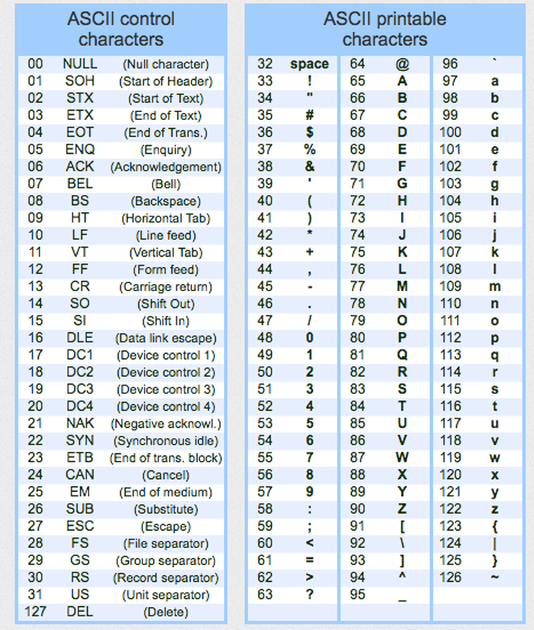
TEXT AS NUMBERS
The table has the following structure
Characters | Codes
Space | 32
0-9 | 48-57
A-Z | 65-90
a-z | 97-122

Slide 9
TEXT AS NUMBERS
What’s the difference between capital A and lowercase a?
Characters | Codes
Space | 32
0-9 | 48-57
A-Z | 65-90
a-z | 97-122

Slide 10
TEXT AS NUMBERS
It’s exactly 32, one bit, the fifth bit (2⁵)
0100001 = A = 65
0110001 = a = 97
Characters | Codes
Space | 32
0-9 | 48-57
A-Z | 65-90
a-z | 97-122

Slide 11
TEXT AS NUMBERS
What problem do you forsee with this encoding scheme?
Characters | Codes
Space | 32
0-9 | 48-57
A-Z | 65-90
a-z | 97-122

Slide 12
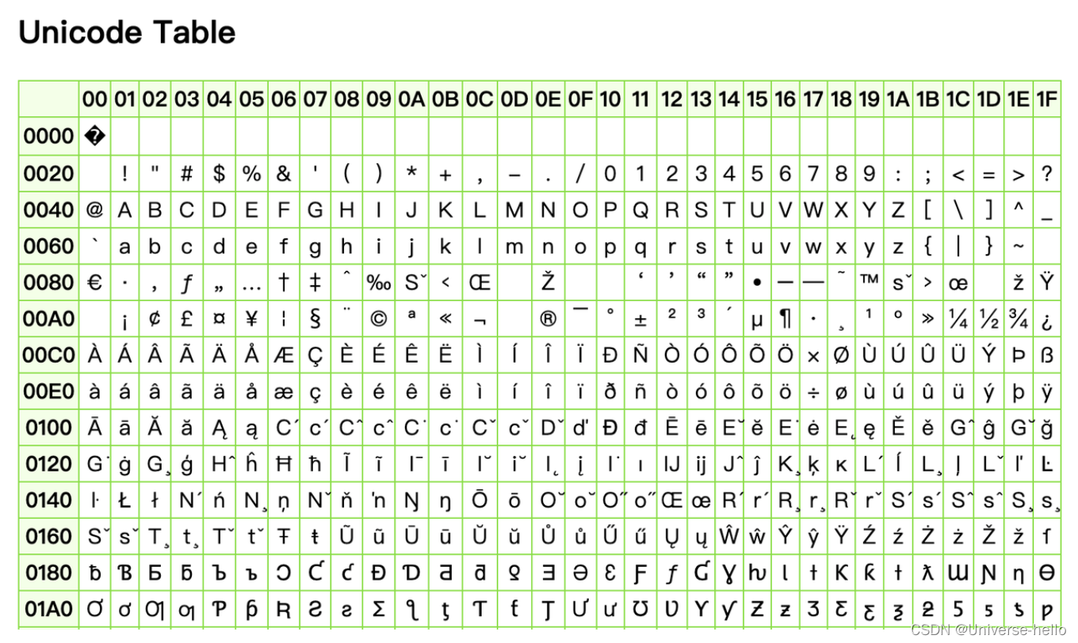
TEXT AS NUMBERS
Of course, 128 wasn’t enough characters
Modern Unicode has 150,000+ characters
  Including emoji!
  The first 128 bits of Unicode correspond to the first 128 bits of ASCII, making it backwards compatible
Characters | Codes
Space | 32
0-9 | 48-57
A-Z | 65-90
a-z | 97-122

Slide 13
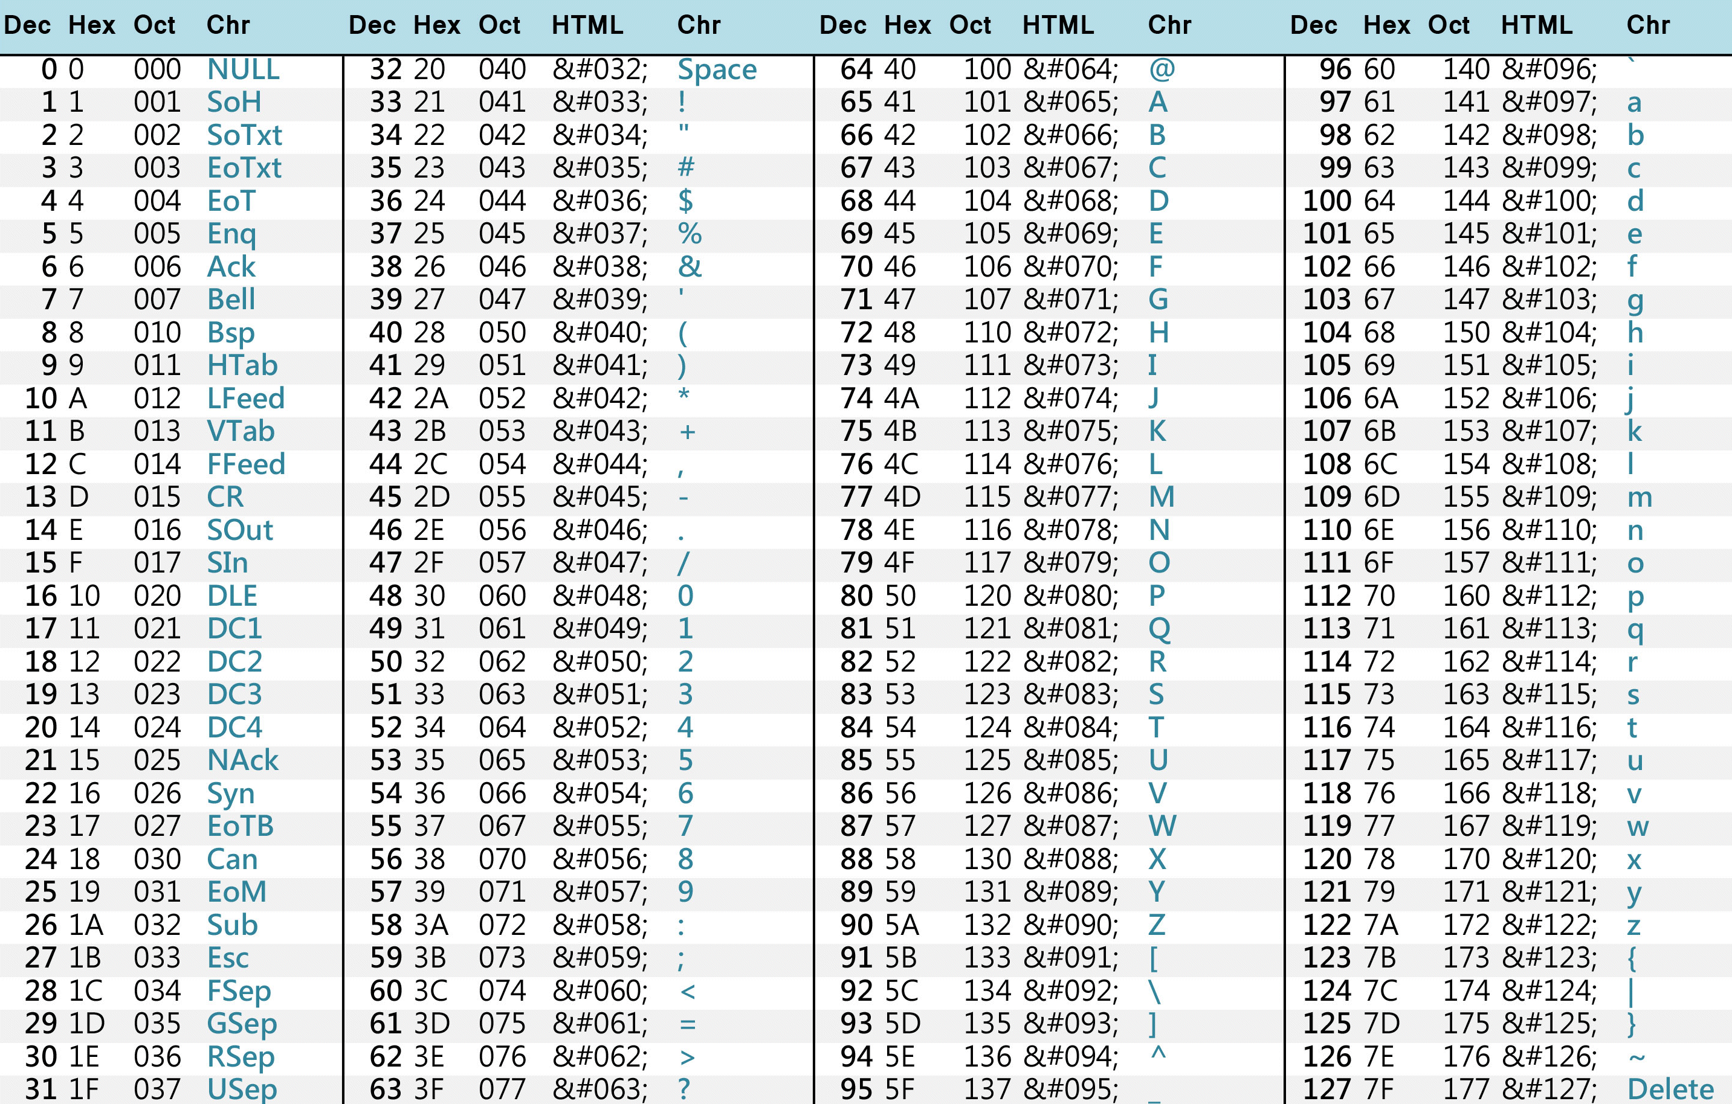
TEXT AS NUMBERS
Do the first 4 questions on your ICA using the ASCII table. Feel free to use a calculator.
Characters | Codes
Space | 32
0-9 | 48-57
A-Z | 65-90
a-z | 97-122

Slide 14

IMAGES AS NUMBERS
This is an image of John Cena

Slide 15

IMAGES AS NUMBERS
Closer!

Slide 16

IMAGES AS NUMBERS
Let’s get real close up in there
  I’ve added boundaries so you can see it clearly

Slide 17
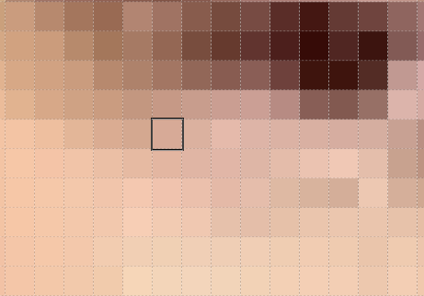
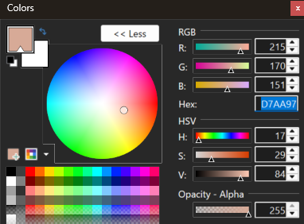
IMAGES AS NUMBERS
All* images, like this one, are represented by a grid of cells called pixels
Every cell is represented by a number
  D7AA97
  What type of number is this?
  How many bits does this number take up?

Slide 18
IMAGES AS NUMBERS
If each pixel is 24 bits, an 8x8 pixel grid takes up how many bits?
How many bytes?

Slide 19
IMAGES AS NUMBERS
Let’s simplify here so we can see the big picture
8 x 8 grid
In our grid, each pixel will either be 0 or 1, on or off, white or black
Line 1: 00000000
Line 2: 00100100
Line 3: 00100100
Line 4: 00000000
Line 5:
Line 6:
Line 7
Line 8:

Slide 20
IMAGES AS NUMBERS
64 bit image, 8 bytes

Slide 21
IMAGES AS NUMBERS
Now, draw a symbol yourself on the back of your page (HIDE YOUR IMAGE)
Then, on a sheet of notebook paper, write out the binary representation of your image
  DO NOT split your binary up on lines, write it all in sequence
Then, pass your binary representation to your partner, and have them try to draw your image

Slide 22
IMAGES AS NUMBERS
Did anything go wrong in the transfer? Answer in question 7.

Slide 23
IMAGES AS NUMBERS
You can use more than 1 bit for color, like seen earlier.
n bits per pixel -> 2^{n} colors
1 bit = 2
4 bit = 16
8 bit = 256
24 bit color (like John Cena) -> 16,777,216
BUT!
  1920 x 1080 (modern screen sizes) x 24 bits = ???

Slide 24
IMAGES AS NUMBERS
6.2 MEGABYTES (million bytes)
Answer questions 5a and 5b

Slide 25
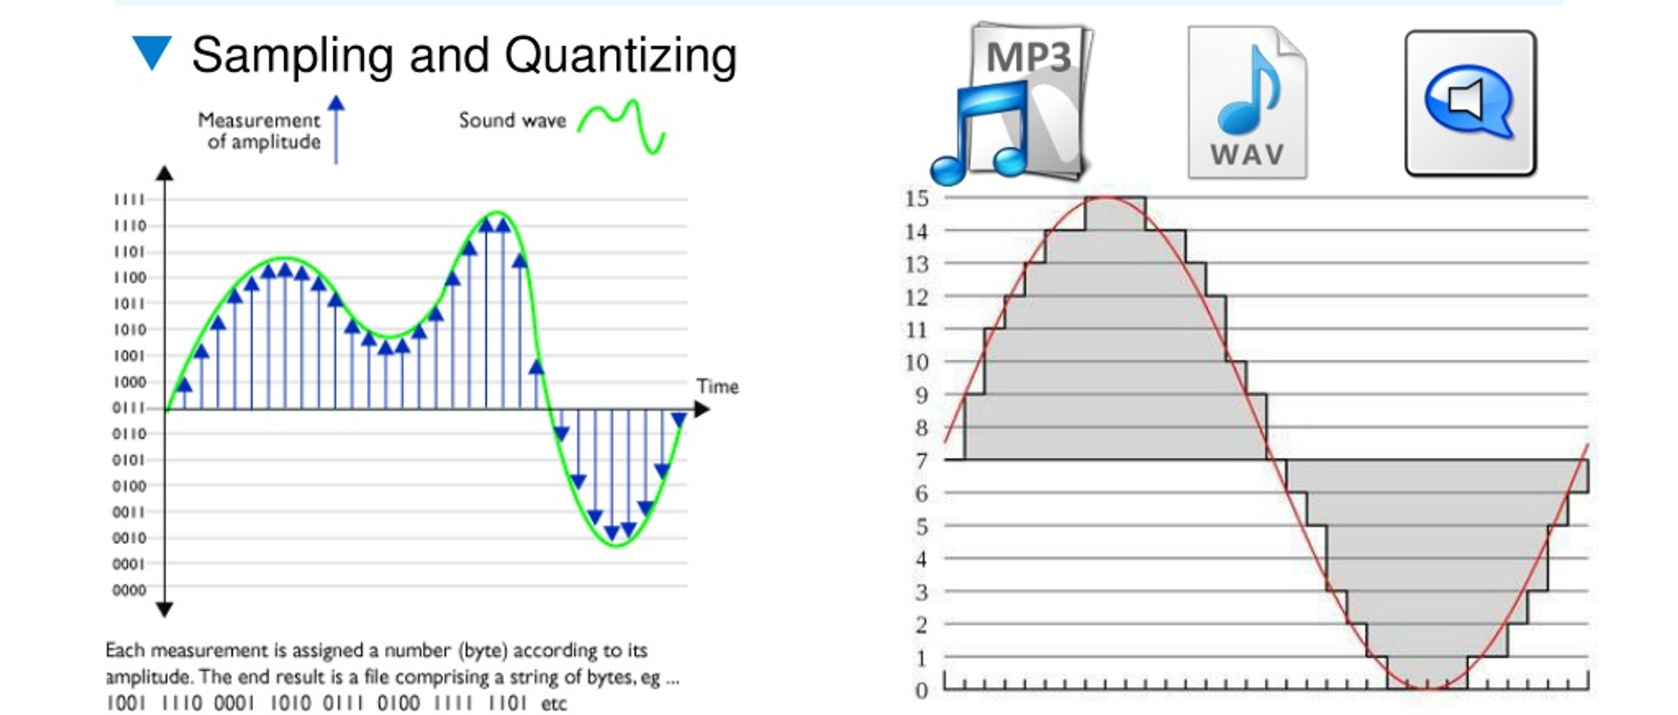
SOUND AS NUMBERS
You can’t store a curve

Slide 26
SOUND AS NUMBERS
Sample Rate – how often you measure the amplitude (the tickmarks on the bottom of the graph)

Slide 27
SOUND AS NUMBERS
Bit depth – how precisely you record each measurement – the horizontal bars of the graph

Slide 28

SOUND AS NUMBERS
CD Quality:
  44,100 samples per second – sample rate (44.1 kilohertz, kHz)
  16 bits per sample – how many levels of fidelity?
  2 channels (left and right ear audio sepeartely)
  Calculate how many bits per second this audio takes
  Answer question 5c

Slide 29
SOUND AS NUMBERS
We use 44.1 kHz because it’s about twice the highest frequency the human ear can hear, ~20 kHz

Slide 30

SOUND AS NUMBERS
Which sounds better?

Slide 31
SOUND AS NUMBERS
44.1 kHz, 16 bits per sample vs. 8 kHz, 8 bits per sample

Slide 32
SOUND AS NUMBERS
In unit 3, you’ll be given the option to create music for the NES soundchip
  The music on that system is handled entirely differently, which programmed audio coming out of 5 different voices
    There is no compression, but in exchange for that the music is constrained to technical limitations

Slide 33
COMPRESSION
Run-length encoding:
  WWWWWBBW -> 5W 2B 1W
    Saves space compared to original
  WBWBWBWB -> 1W 1B 1W 1B 1W 1B 1W 1b
    Is longer than the original
This compression technique can saves space on data that is repetitive
Do question 6

Slide 34
COMPRESSION
Run length encoding is known as lossless compression
Lossless | Lossy
Every original bit comes back | Some data is lost forever
RLE, ZIP, PNG, FLAC | JPEG, MP3, MP4 (most video also)
Smaller than original | MUCH smaller than original

Slide 35
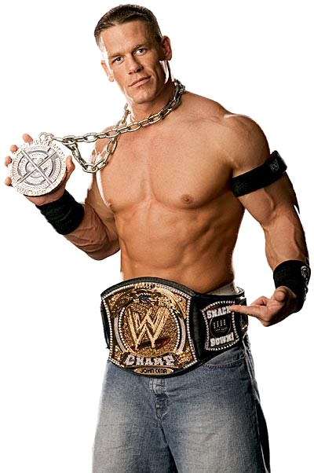



COMPRESSION
Let’s look at JPEG compression at different quality levels
  JPEG100, JPEG30, JPEG5, and JPEG1

Slide 36
COMPRESSION
The question isn’t “what’s better?” (that’s obvious)
  The question is “What am I willing to lose, and what do I get for it?
130 kilobytes (thousand)
21 kilobytes (thousand)
9 kilobytes (thousand)
8 kilobytes (thousand)

Slide 37
MECHANIC BANK
Update your mechanic bank with two (or more!) possible game mechanics based on what we’ve talked about today
  Possible example: You may compress your hand – any run of matching cards becomes one token, but a compressed run can’t be split later

Slide 38
CLOSING
So far, we’ve stored numbers. Next time, we learn to make decisions with them – and it turns out that three operations are enough to build almost anything.

